Slide 1
Compiler Construction
Teacher : Zulfiqar Ali
Email: Zulfiqar.rafique@nu.edu.pk
Office: No.6,Basement -1 (CS Block 1)

Slide 2
Syllabus
Prerequisite:
Theory of Automata
Contents:
Introduction to interpreter and compiler. Compiler techniques and methodology, Organization of compilers; Lexical and syntax analysis; Parsing techniques. Types of parsers, top-down parsing, bottom-up parsing, Type checking, Semantic analyser, Object code generation and optimization, detection and recovery from errors.

Slide 3
Course Learning Outcomes (CLO’s)
No | CLO | Domain | Taxonomy level
1 | Understand the basic techniques used in compiler construction such as lexical analysis, top-down, bottom-up parsing, context-sensitive analysis, and intermediate code generation | C | 2 (Understand)
2 | Understand the basic data structures used in compiler construction such as abstract syntax trees, symbol tables, three-address code, and stack machines | C | 2 (Understand)
3 | Design and implement a compiler using a software engineering approach. | C | 3 (Apply)
4 | Use generators (e.g. Lex and Yacc) | C | 3 (Apply)

Slide 4
Teaching Methodology:
Lectures, Written Assignments, Semester Project, Presentations
Course Assessment:
Quizzes, Assignments, Mid Exams, Project, Presentations, Final Exam

Slide 5
Recommended & Reference Books
Text Book
Compilers: Principles, Techniques, and Tools 2nd Edition by Alfred Aho , Jeffrey Ullman, Ravi Sethi, Monica Lam
Reference Book
Introduction to Compilers and Language Design - Prof. Douglas Thain University of Notre Dame – 2nd Edition
Crafting a Compiler – Charles N-Fischer, Richard
Principles of Compiler Design, 3rd Edition by Nandini Prasad K.S Elsevier

Slide 6
Assessment Details
Project: (10 Marks) It will be Design (Presented on Charts-Atleast 5) + Code
Assignments (5 Marks) 5 Assignments (Best 3) Assignments will be Paper/Chart Work
Quizzes: (5 Marks)
5 Quizzes (Best 3) Design , Conceptual, Logical and Numerical Type
Mid Exams (30 Marks)
Final Exam (50 Marks)

Slide 7
Week 1:
Course Introduction
Language Processors
Compiler Vs Interpreters
Structure of Compilers
Types of Compilers
Programming Languages and Compilers

Slide 8
Language Processors
Language processing, which is concerned with preparing a program to be run on a computer.
Most programs are written in a relatively high-level language.
Language processors verify a program follows its language rules and convert it into machine executable form.
Some language processors perform more translation than others.

Slide 9
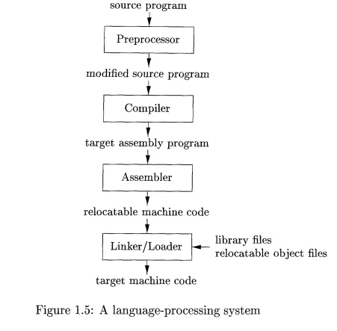

Slide 10
Pre-processor
A pre-processor produce input to compilers. They may perform the following functions.
Macro processing: A Preprocessor may allow a user to define macros that are short hands for longer constructs.
File inclusion: A Preprocessor may include header files into the program text.

Slide 11
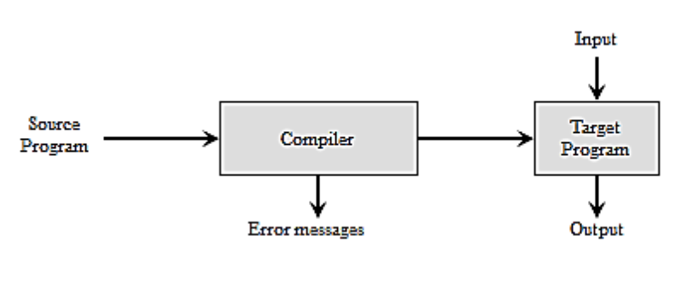
COMPILER
Compiler is a translator program that translates a program written in (HLL) the source program and translate it into an equivalent program in (MLL) the target program. As an important part of a compiler is error showing to the programmer.

Slide 12
Assembler
Programmers found it difficult to write or read programs in machine language. They begin to use a mnemonic (symbols) for each machine instruction, which they would subsequently translate into machine language.
Such a mnemonic machine language is now called an assembly language. Programs known as assembler were written to automate the translation of assembly language in to machine language.
The input to an assembler program is called source program, the output is a machine language translation (object program).

Slide 13
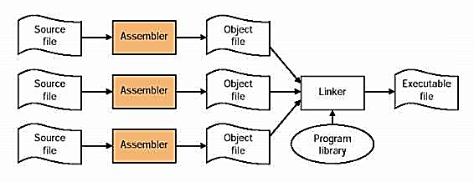
Linker/Loader
After assembly, the object program must be loaded into memory for execution. Early assemblers could load programs directly but wasted memory by staying resident. Reloading the program each time also wasted translation time. To solve this, loaders were introduced—they place programs in memory, adjust addresses (relocation), and prepare them for execution efficiently.

Slide 14
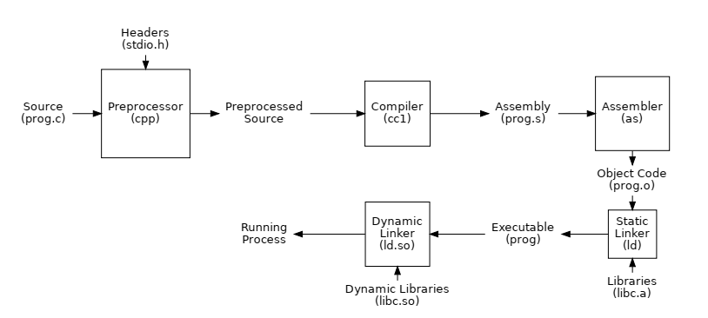

Slide 15
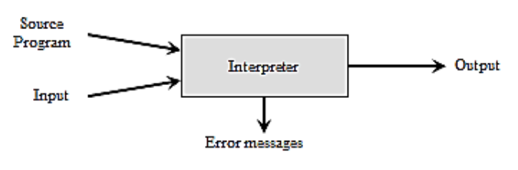
Compilers VS Interpreters
Compilers | Interpreters
Takes Entire program as input It is Faster Intermediate object code is generated. Required more memory Due to intermediate object code Program not need compile every time Errors are displayed after entire program is checked Debugging is comparatively hard. Ex: C, C++ | Take single instruction as input It is Slower No intermediate code is generated Required less memory As no intermediate code is generated Every time higher level program is converted into lower level program. Errors are displayed for every instruction interpreted. Debugging is easy. Ex: python, Ruby, basic.

Slide 16
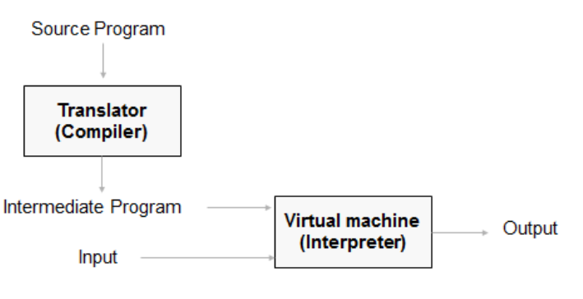
Hybrid Compilers
Compilation and interpretation may be combined to implement a programming language:
The compiler may produce intermediate-level code which is then interpreted rather than compiled to machine code.
Ex: java

Slide 17
Compiler Construction Tools
Parser generators that automatically produce syntax analysers from a grammatical description of a programming language.
Scanner generators that produce lexical analysers from a regular-expression description of the tokens of a language.
Syntax-directed translation engines that produce collections of routines for walking a parse tree and generating intermediate code.
Code-generator generators that produce a code generator from a collection of rules for translating each operation of the intermediate language into the machine language for a target machine.
Data-flow analysis engines that facilitate the gathering of information about how values are transmitted from one part of a program to each other part. Data-flow analysis is a key part of code optimization.
Compiler-construction toolkits that provide an integrated set of routines for constructing various phases of a compiler.

Slide 18
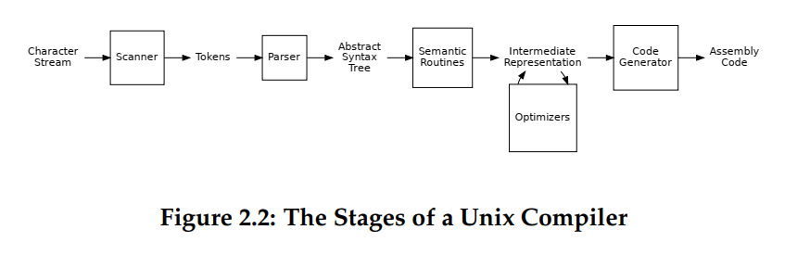
Structure of Compiler

Slide 19
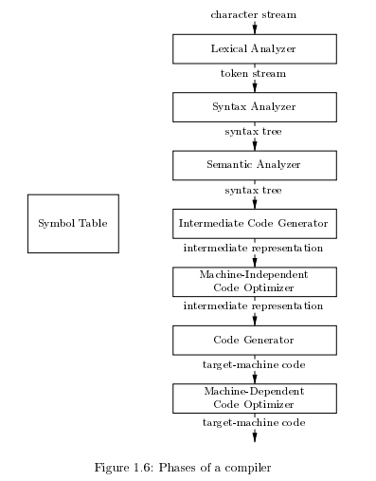

Slide 20
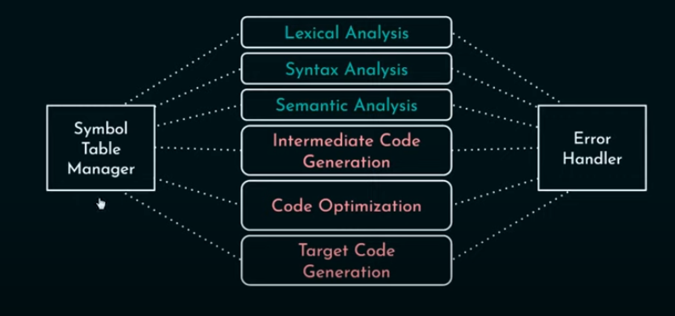

Slide 21
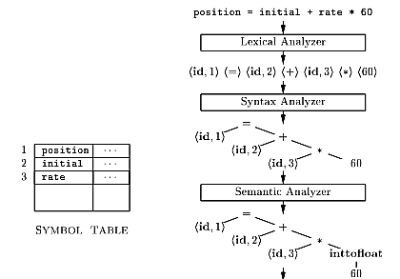
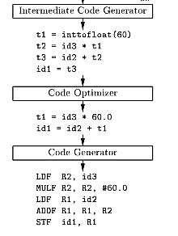

Slide 22
Lexical Analysis
The first phase of a compiler is called lexical analysis or scanning.
It reads the stream of characters making up the source program and groups the characters into meaningful sequences called lexemes.
For each lexeme, the lexical analyzer produces as output a token of the form that it passes on to the subsequent phase, syntax analysis. (token-name; attribute-value)

Slide 23
(Token-name; attribute-value)
In the token, the first component token-name is an abstract symbol that is used during syntax analysis, and the second component attribute-value points to an entry in the symbol table for this token.
Information from the symbol-table entry is needed for semantic analysis and code generation.

Slide 24
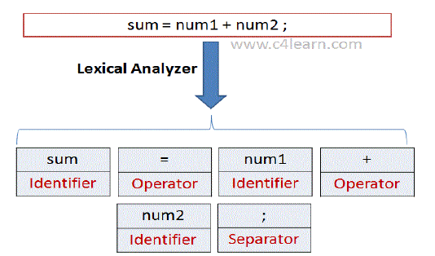
Lexical Units
Lexical Analysis Identifies Different Lexical Units in a Source Code.
Some Lexical Classes are:
Identifiers
Constants
Keywords
Operators
Punctuators

Slide 25
Example
Suppose a source program contains the assignment statement.
position = initial + rate * 60
The characters in this assignment could b e grouped into the following lexemes.
Position → Identifier
= → Operator
Initial → Identifier
+ → Operator
Rate → Identifier
* → Operator
60 → Constant

Slide 26
And mapped into the following tokens passed on to the syntax analyzer.
position is a lexeme that would b e mapped into a token (id; 1), where id is an abstract symbol standing for identifier and 1 points to the symbol-table entry for position. The symbol-table entry for an identifier holds Information about the identifier, such as its name and type.
The assignment symbol = is a lexeme that is mapped into the token (=) . Since this token needs no attribute-value.

Slide 27
initial is a lexeme that is mapped into the token (id; 2), where 2 points to the symbol-table entry for initial.
+ is a lexeme that is mapped into the token (+).
rate is a lexeme that is mapped into the token (id; 3), where 3 points to the symbol-table entry for rate.
* is a lexeme that is mapped into the token (*).
60 is a lexeme that is mapped into the token (60).
Blanks separating the lexemes would b e discarded by the lexical analyzer.
(id, 1) (=) (id, 2) (+)(id, 3) (*) (60)

Slide 28
In this representation, the token names =, + and * are abstract symbols for the assignment, addition, and multiplication operators, respectively.
Here lexeme 60 should have token (id, 60), but we are not doing this,, we will discuss this in details in upcoming lectures.

Slide 29
Syntax Analysis
The second phase of the compiler is syntax analysis or parsing. The parser uses the first components of the tokens produced by the lexical analyzer to create a tree-like intermediate representation that depicts the grammatical structure of the token stream.
A typical representation is a syntax tree in which each interior node represents an operation and the children of the node represent the arguments of the operation.

Slide 30
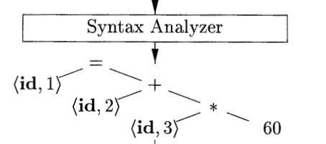
position = initial + rate * 60
This tree shows the order in which the operations in the assignment are to be performed
The tree has an interior node labeled * with (id, 3) as its left child and the integer 60 as its right child.
The node (id, 3) represents the identifier rate.
The node labeled * makes it explicit that we must first multiply the value of rate by 60.

Slide 31
position = initial + rate * 60
The node labeled + indicates that we must add the result of this multiplication to the value of initial.
The root of the tree, labeled =, indicates that we must store the result of this addition into the location for the identifier position.
This ordering of operations is consistent with the usual conventions of arithmetic which tell us that multiplication has higher precedence than addition, and hence that the multiplication is to be performed before the addition.

Slide 32
Semantic Analysis
The semantic analyzer uses the syntax tree and the information in the symbol table to check the source program for semantic consistency with the language definition.
It also gathers type information and saves it in either the syntax tree or the symbol table, for subsequent use during intermediate-code generation.
An important part of semantic analysis is type checking, where the compiler checks that each operator has matching operands.
For example, many programming language definitions require an array index to be an integer, the compiler must report an error if a floating-point number is used to index an array

Slide 33
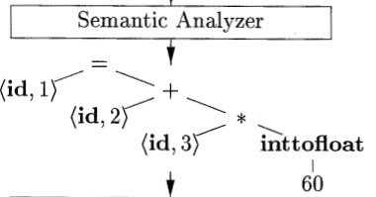
The language specification may permit some type conversions called coercions. For example, a binary arithmetic operator may be applied to either a pair of integers or to a pair of floating-point numbers. If the operator is applied to a floating-point number and an integer, the compiler may convert or coerce the integer into a floating-point number.
Such a coercion appears in Fig. 1.7. Suppose that position, initial, and rate have been declared to be floating-point numbers, and that the lexeme 60 by itself forms an integer. The type checker in the semantic analyzer in Fig. 1.7 discovers that the operator * is applied to a floating-point number rate and an integer 60. In this case, the integer may be converted into a floating-point number.

Slide 34
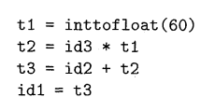
Intermediate Code Generator
After syntax and semantic analysis of the source program, many compilers generate an explicit low-level or machine-like intermediate representation. which we can think of as a program for an abstract machine.
This intermediate representation should have two important properties: it should be easy to produce and it should be easy to translate into the target machine.
The output of the intermediate code generator consists of the three-address code sequence

Slide 35
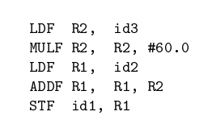
Machine Code Generation
The code generator takes as input an intermediate representation of the source program and maps it into the target language.
If the target language is machine code, registers or memory locations are selected for each of the variables used by the program.
Then, the intermediate instructions are translated into sequences of machine instructions that perform the same task.
A crucial aspect of code generation is the judicious assignment of registers to hold variables.
For example, using registers R1 and R2, the intermediate code in (1.4) might get translated into the machine code

Slide 36
Grouping of Phases
In implementation, several phases are grouped into passes.
Front‐end (Analysis) phases are grouped into one pass. Lexical analysis, Syntax analysis, Semantic analysis, Intermediate code generation
Optimization is left as an optional pass
Back-End Pass (Synthesis) phases, This includes Code Generation

Slide 37
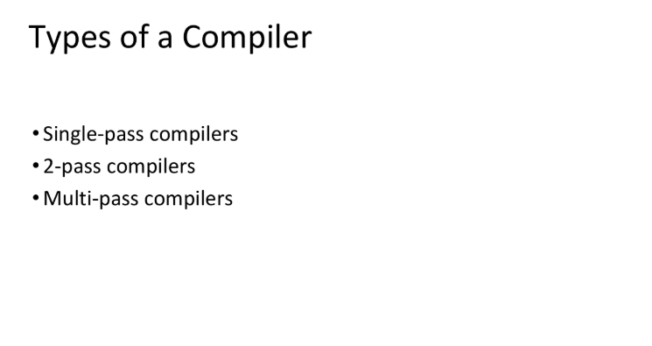

Slide 38
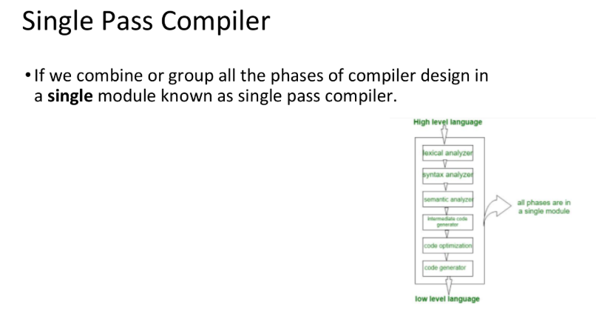

Slide 39
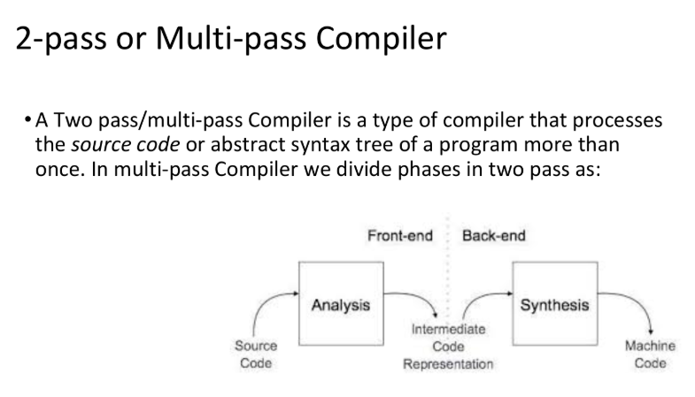

Slide 40
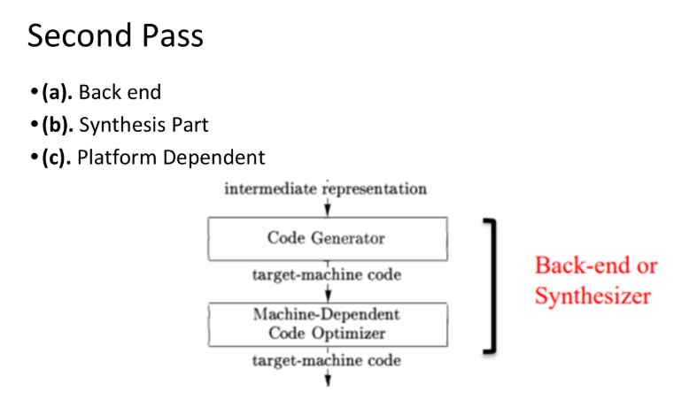

Slide 41
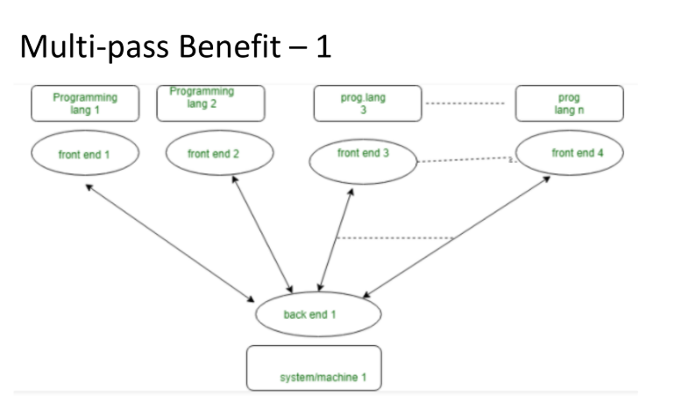

Slide 42
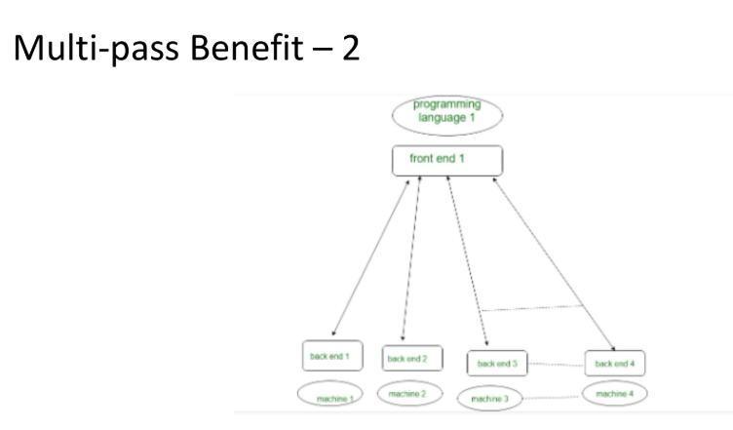

Slide 43
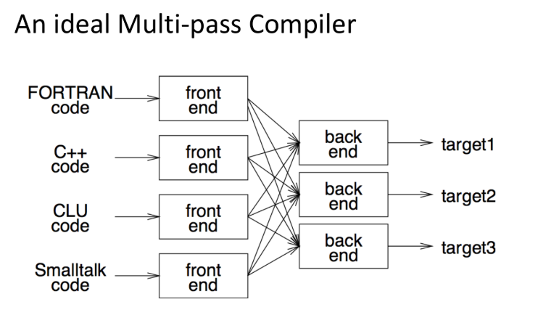

Slide 44
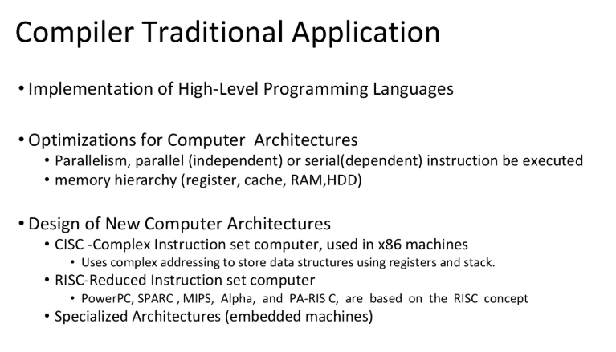

Slide 45
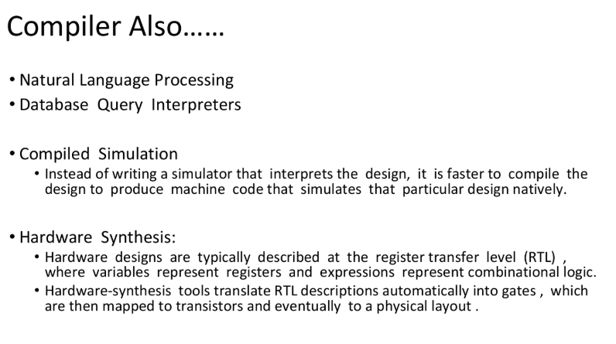

Slide 46
Reference:
Compilers: Principles, Techniques, and Tools 2nd Edition by Alfred Aho , Jeffrey Ullman, Ravi Sethi, Monica Lam
Introduction to Compilers and Language Design | Second Edition | Prof. Douglas Thain - University of Notre Dame

